Slide 1
Metrics in Göttingen Research Online
Daniel Beucke | beucke@sub.uni-goettingen.de
*Metrics in Transition | *metrics Workshop
28. März 2019

Slide 2
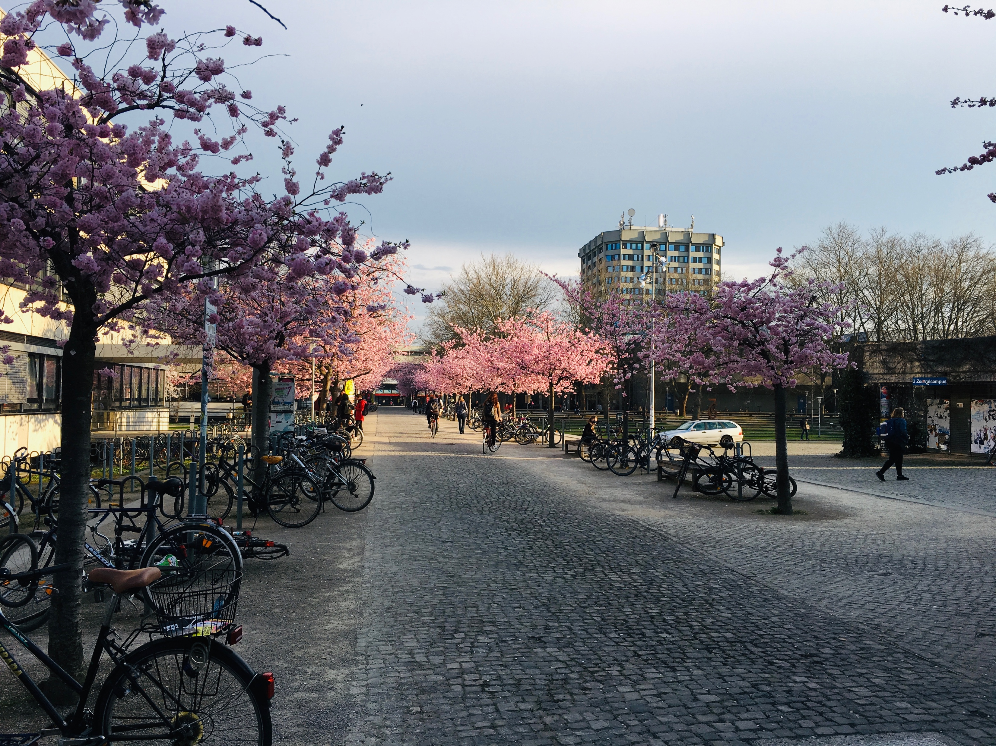

Slide 3
Institutional Repositories @ Uni Göttingen
Doctoral Thesis via eDISS
Parallel and peer reviewed publications from the researchers of the University are visible via GoeScholar
Primary electronic publications of the University is possible with University Press Göttingen and GOEDOC
https://www.sub.uni-goettingen.de/en/electronic-publishing/publishing/

Slide 4

Bringing all the good experiences together ...

Slide 5

Publications
publication data management
DSpace-CRIS
...
Data
research data repository
Dataverse
Instruments
large equipment portal
Open IRIS
Plan
data management planning tool
RDMO
Göttingen Research Online

Slide 6
GRO.Publications
Bibliography for the university
Researcher pages with all/selected publications
Embed function for individual publication lists
Fully integration with ORCID
Coming soon
OA full text integration
Connection with research data repository
API with Göttingen CRIS (FACTScience)

Slide 7
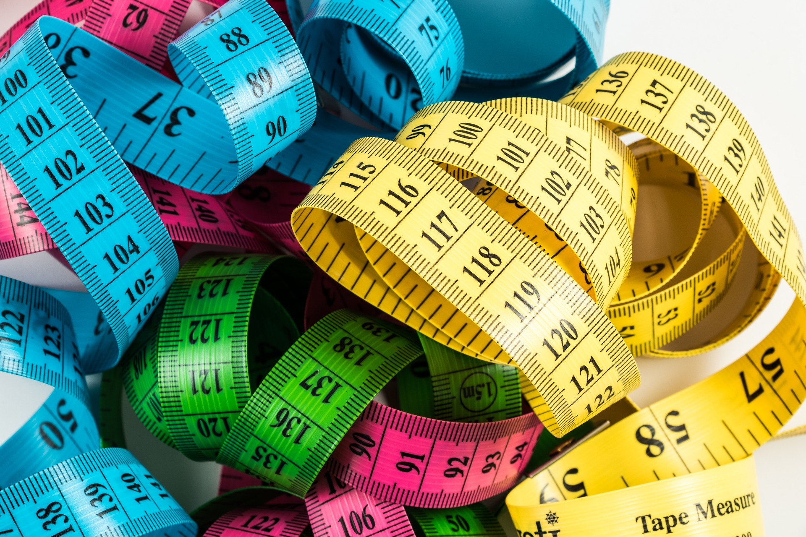

Slide 8
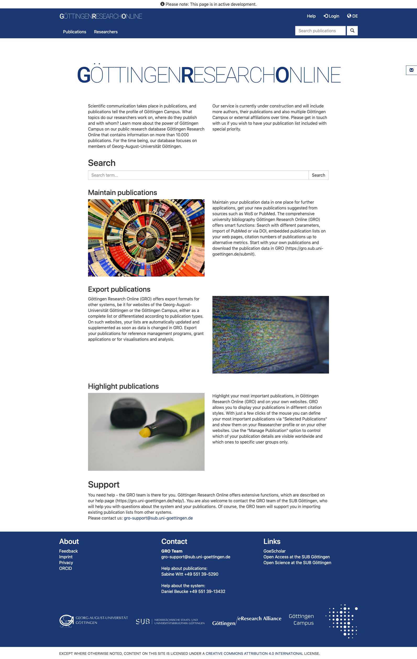
Startpage
Global patterns of plant diversity and floristic knowledge Kier, G. ; Mutke, J. ; Dinerstein, E. ; Ricketts, T. H. ; Küper, W. ; Kreft, H. & Barthlott, W. (2005) Journal of Biogeography, 32(7) (pp. 1107-1116).​
A terrestrial planet candidate in a temperate orbit around Proxima Centauri Anglada-Escude, G. ; Amado, P. J. ; Barnes, J. ; Berdinas, Z. M. ; Butler, R. P. ; Coleman, G. A. L. & de la Cueva, I. u.a. (2016) Nature, 536(7617) (pp. 437-+).​
Development and application of a phylogenomic toolkit: Resolving the evolutionary history of Madagascar's lemurs Horvath, J. ; Weisrock, D. ; Embry, S. L. ; Fiorentino, I. ; Balhoff, J. ; Kappeler, P. & Wray, G. A. et al. (2008) Genome Research, 18(3) (pp. 489-499).​

Slide 9
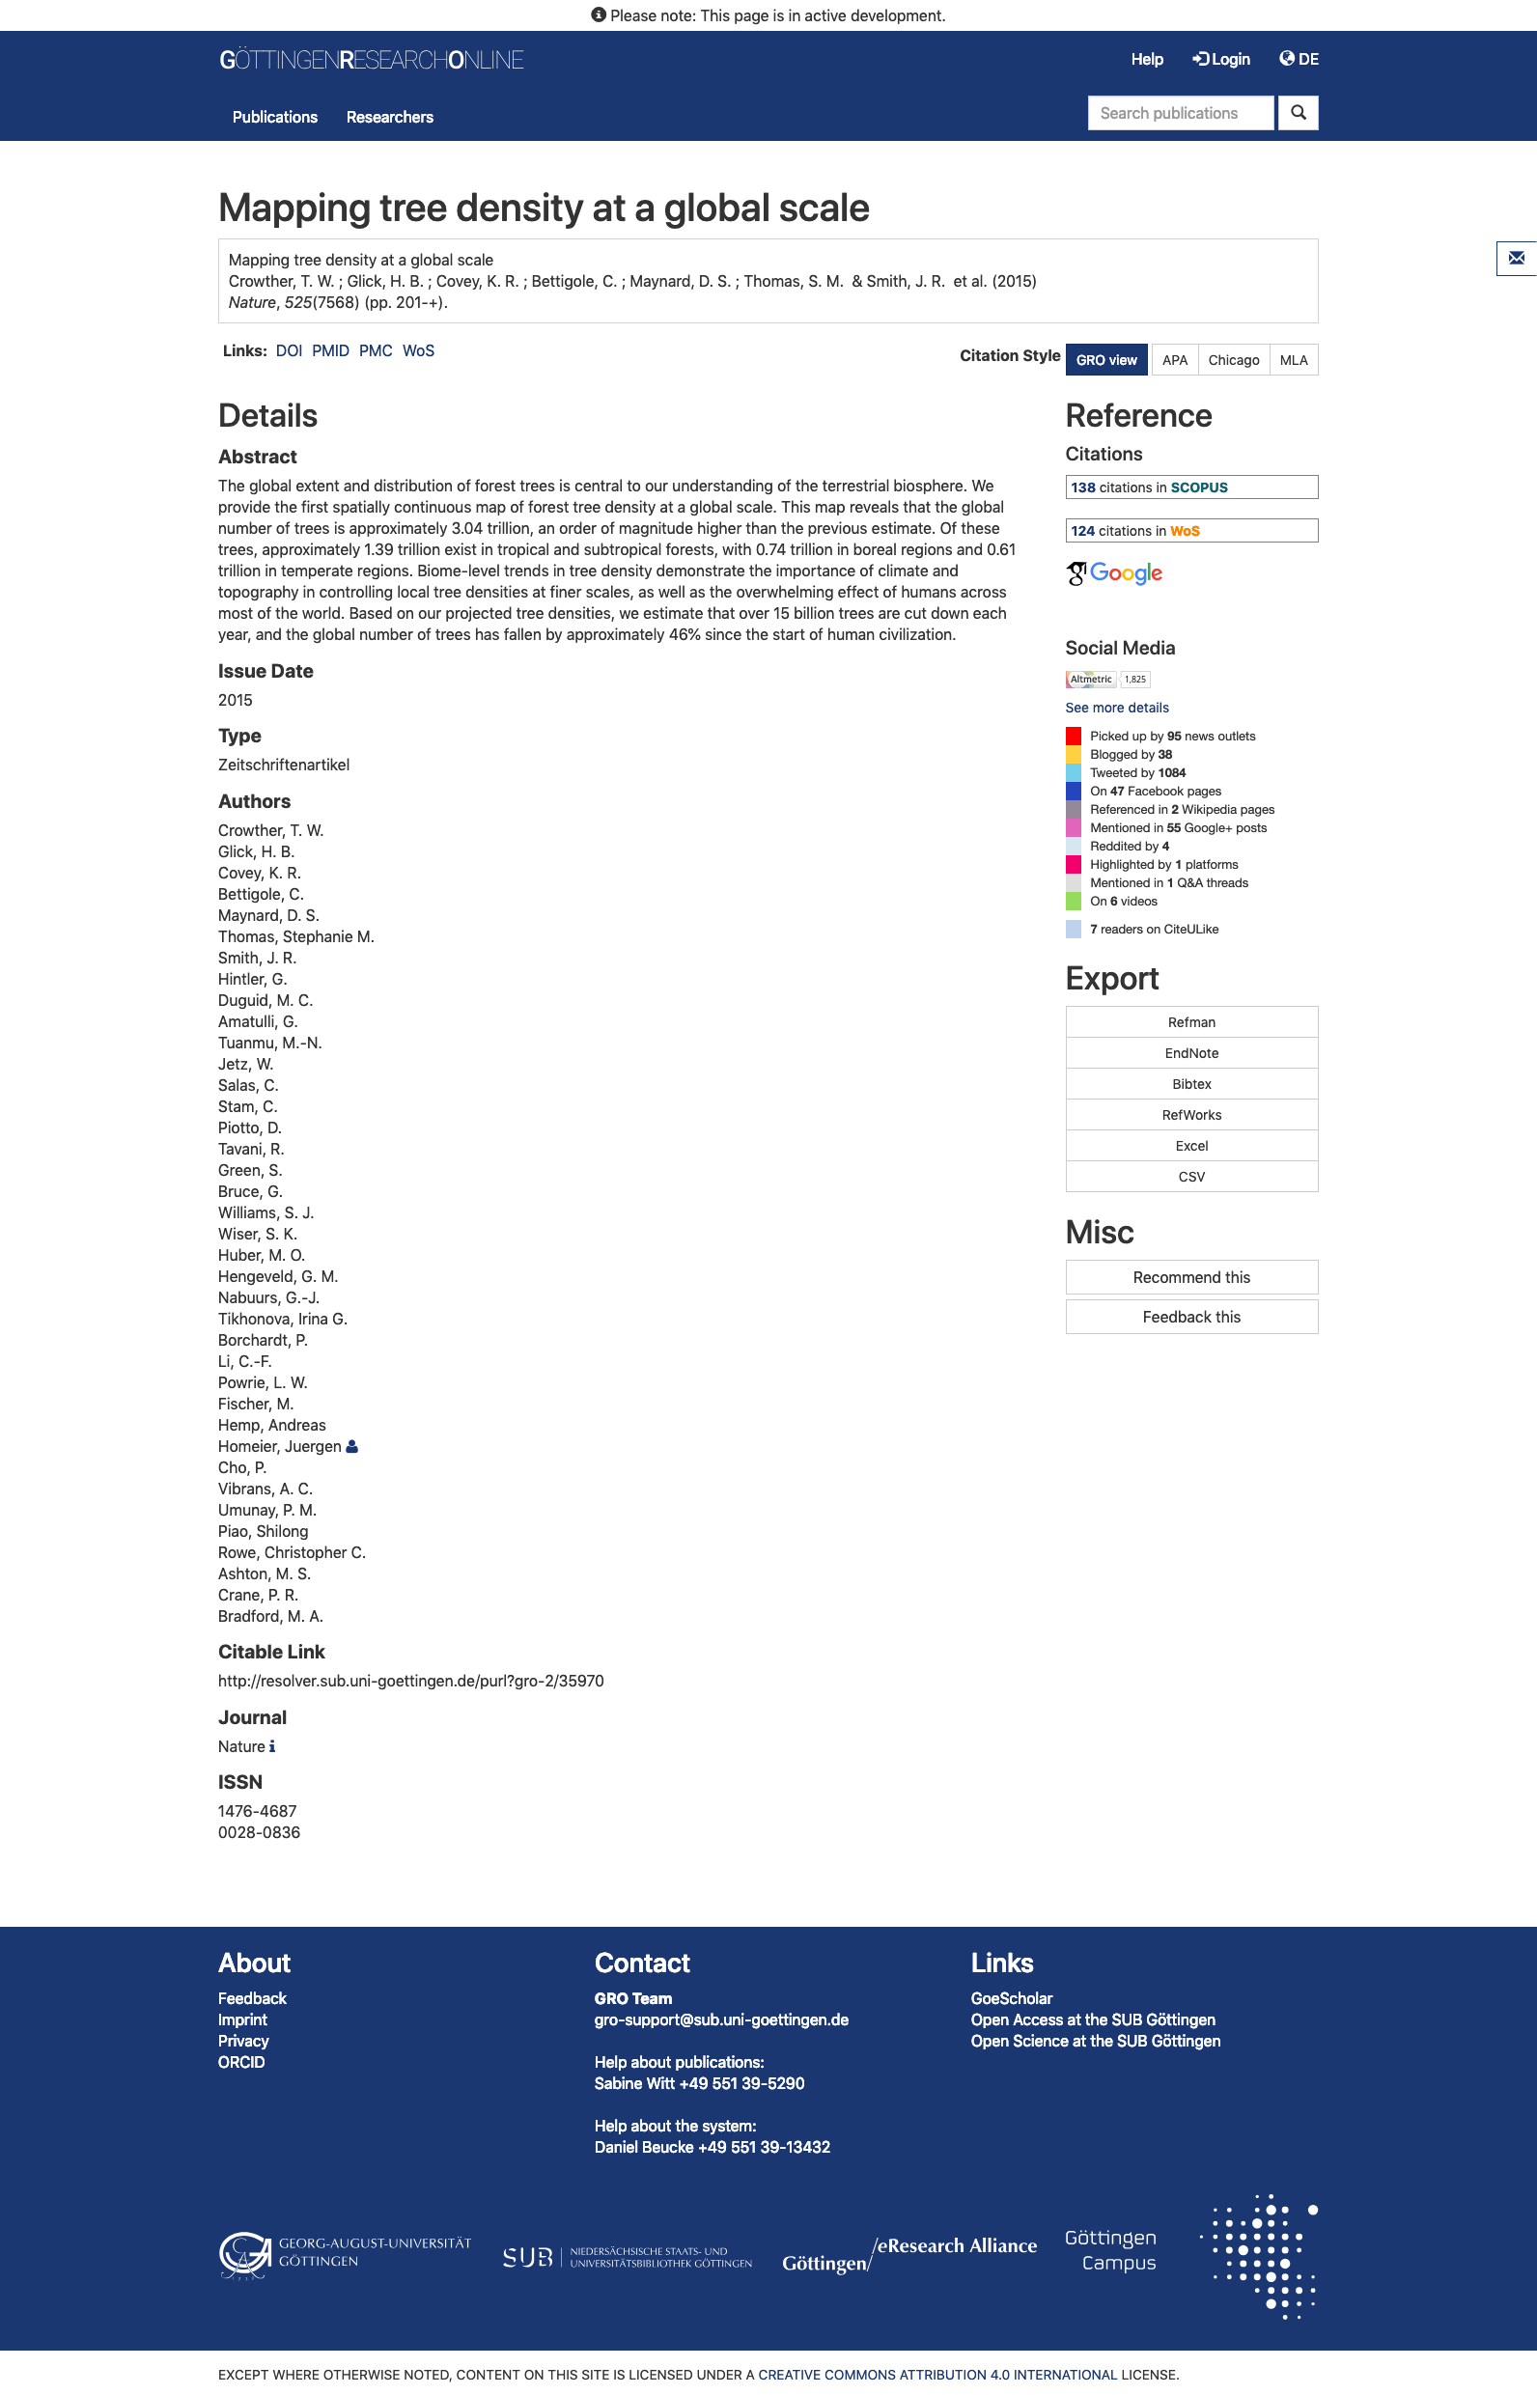
Publication Detail View I

Slide 10
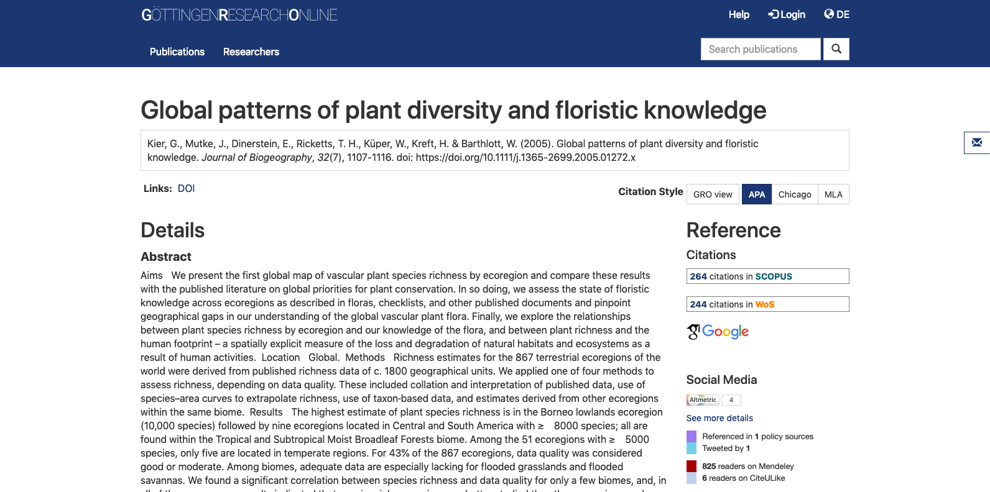
Publication Detail View II

Slide 11
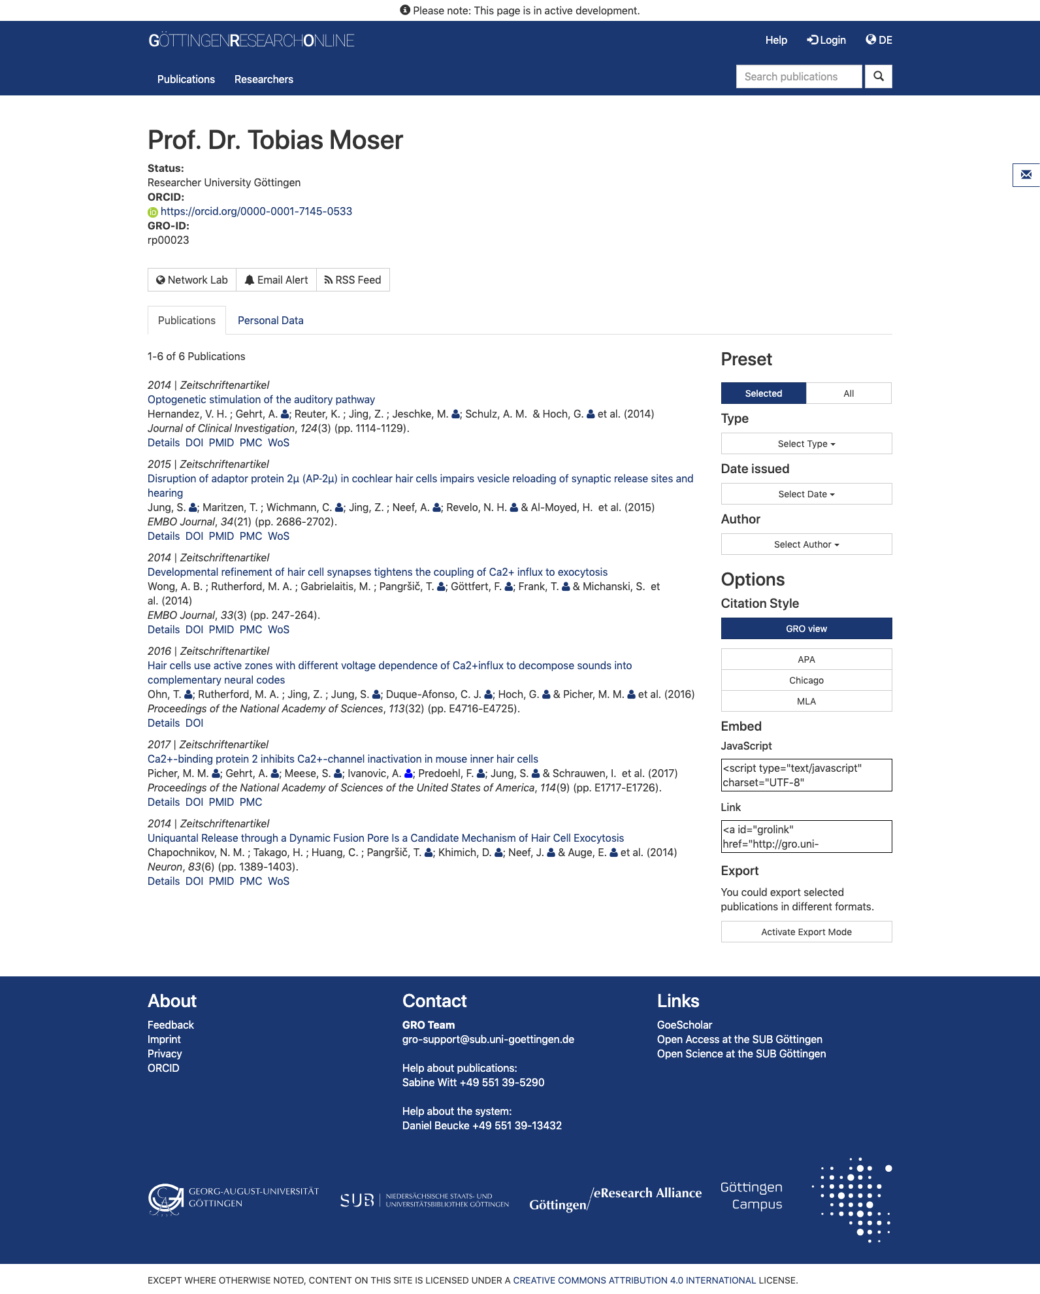
Researcher Page

Slide 12
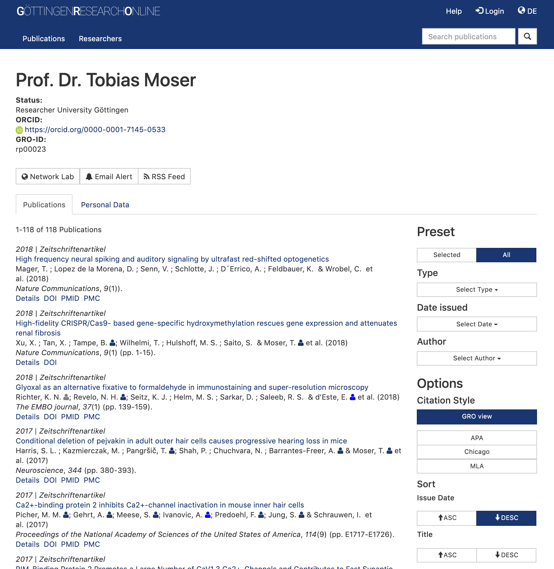
Researcher Page
Wikipedia Mentions
Wikipedia Mentions

Slide 13
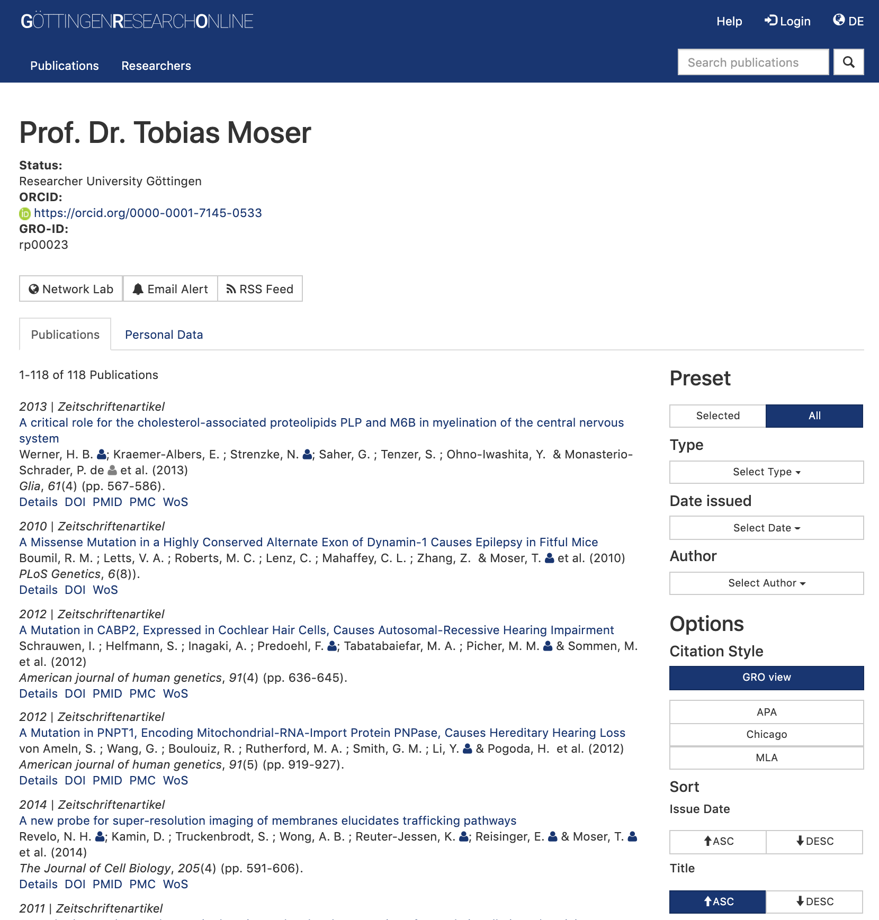
Researcher Page
5 Wikipedia Mentions
3 Wikipedia Mentions
3 Wikipedia Mentions
2 Wikipedia Mentions
1 Wikipedia Mentions
Wikipedia Mentions

Slide 14
Next steps ...
Test with the data from *metrics and Event Data → compare the results
Consider the sustainability or operation of such a service
Ask researchers for feedback

Slide 15


Daniel Beucke
SUB Göttingen
beucke@sub.uni-goettingen.de
Dieses Werk ist lizenziert unter einer Creative Commons Namensnennung 4.0 International Lizenz.

Slide 16
Bildnachweise
Göttingen Campus – eigenes Bild
Würfel – Photo by Olav Ahrens Røtne on Unsplash
Maßband – Bild von Mahesh Patel auf Pixabay
Thanks – Bild von Wokandapix auf Pixabay

